Slide 1

Functions
a.k.a Methods

Slide 2
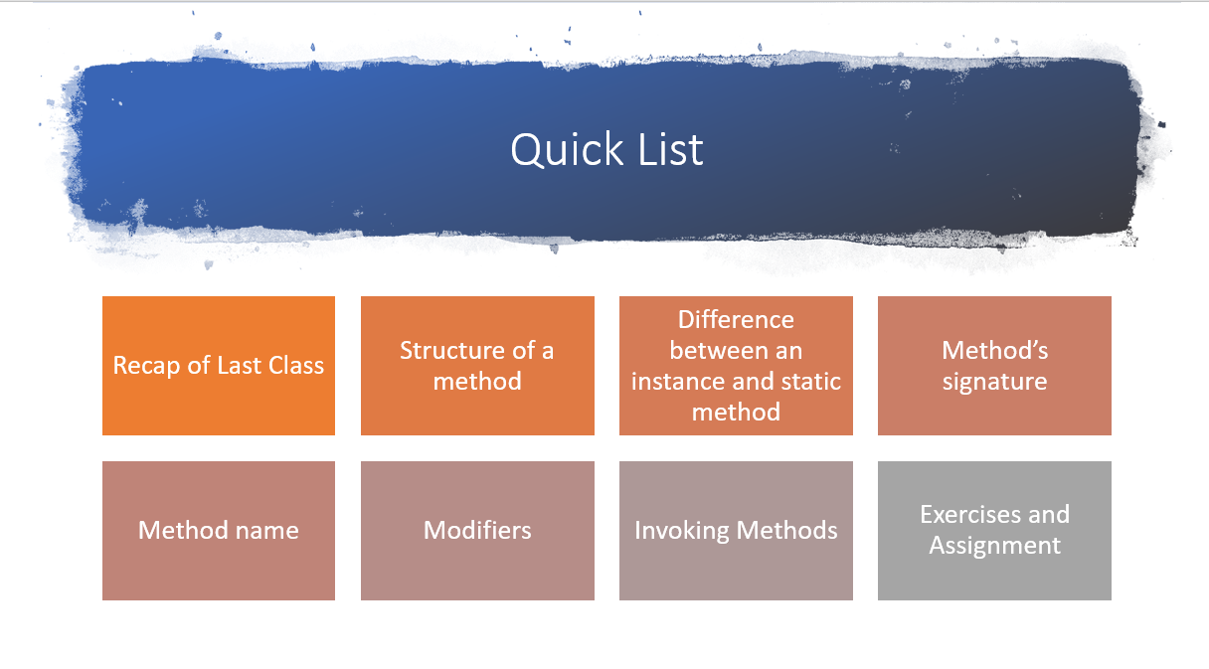

Slide 3

What is a “Method”?
A method is a basic part of a program. It can solve a certain problem, eventually take parameters and return a result.
A method represents all data conversion a program does, to resolve a particular task. Methods consist of the program’s logic.

Slide 4
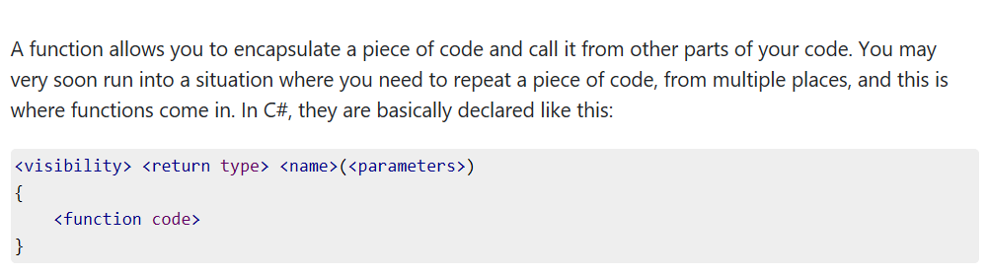

Slide 5
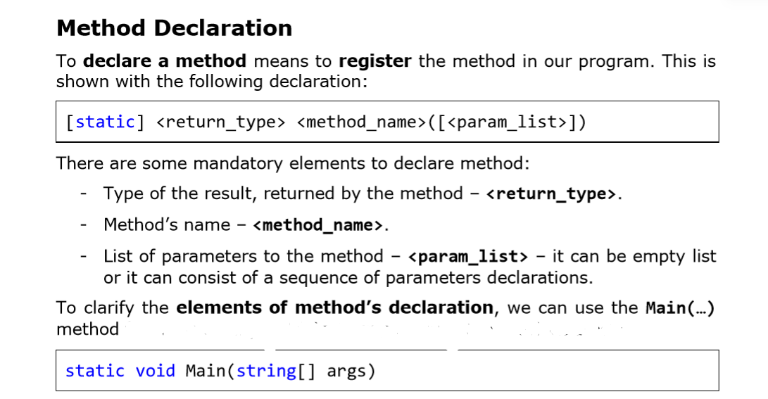

Slide 6
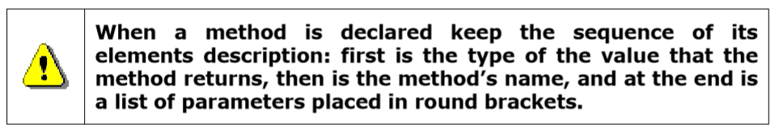
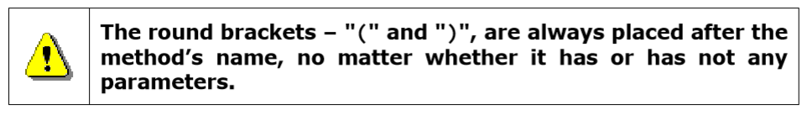
The list with parameters is allowed to be void (empty). In that case the only thing we have to do is to type "()" after the method’s name. Although the method has not parameters the round brackets must follow its name in the declaration.

Slide 7
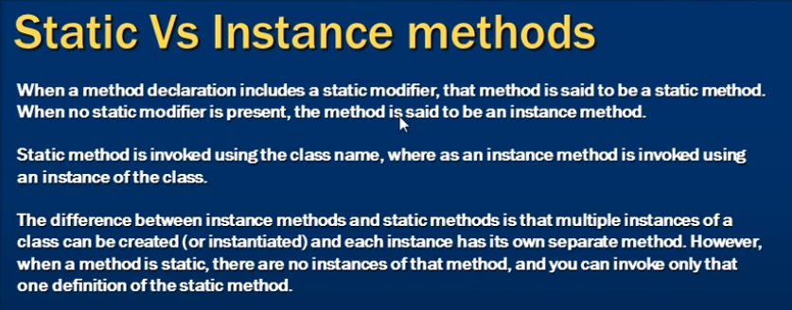

Slide 8
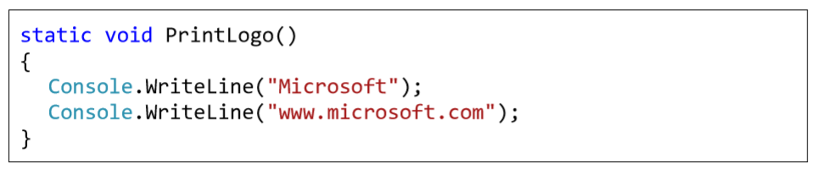
Method Names
Every method solves a particular task from the whole problem that our program solves. Method’s name is used when method is called. Whenever we call (start) a particular method, we type its name and if necessary we pass values (if there are any).
In the example below, the name of our method is PrintLogo:

Slide 9
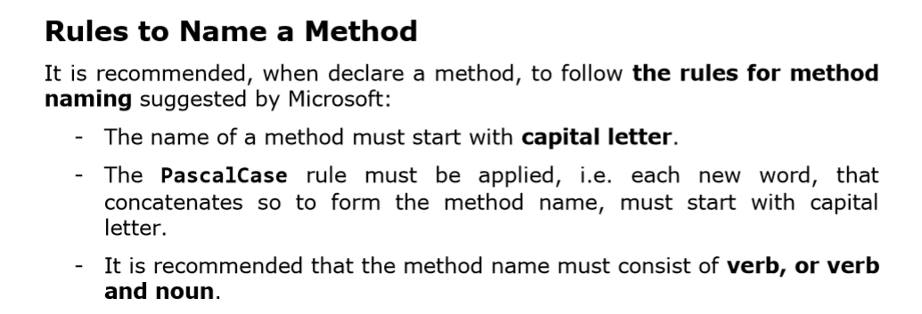

Slide 10
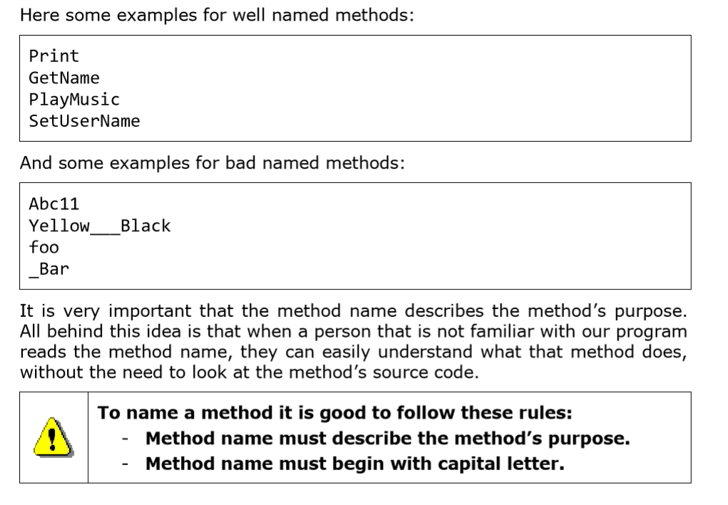

Slide 11
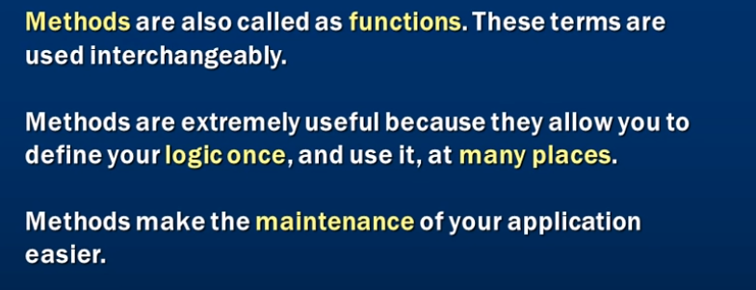
Why methods

Slide 12
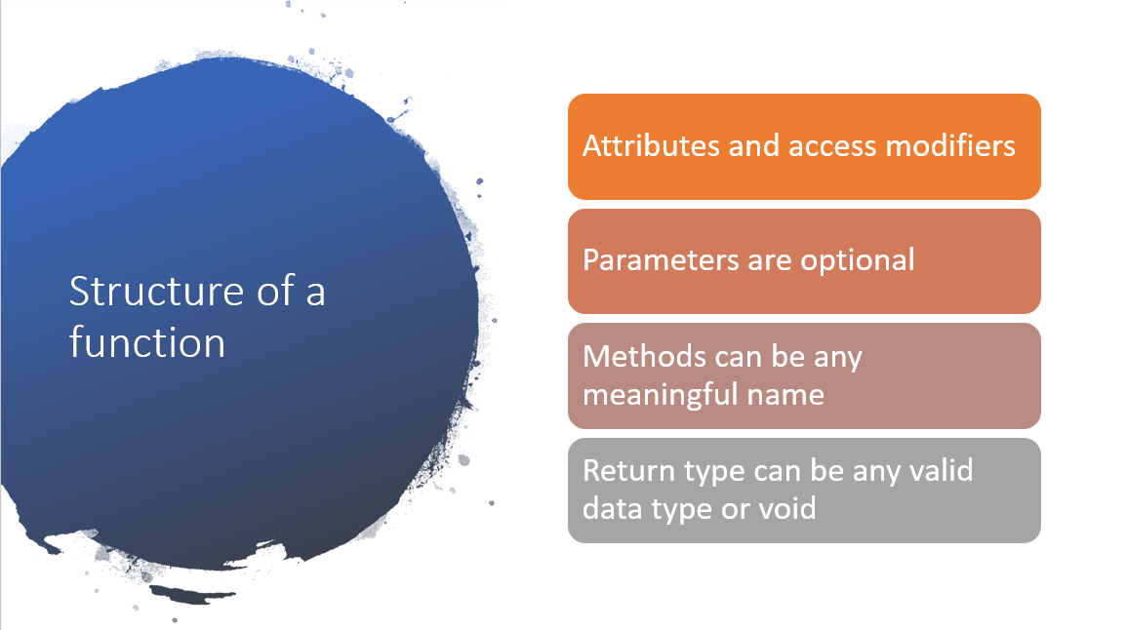

Slide 13
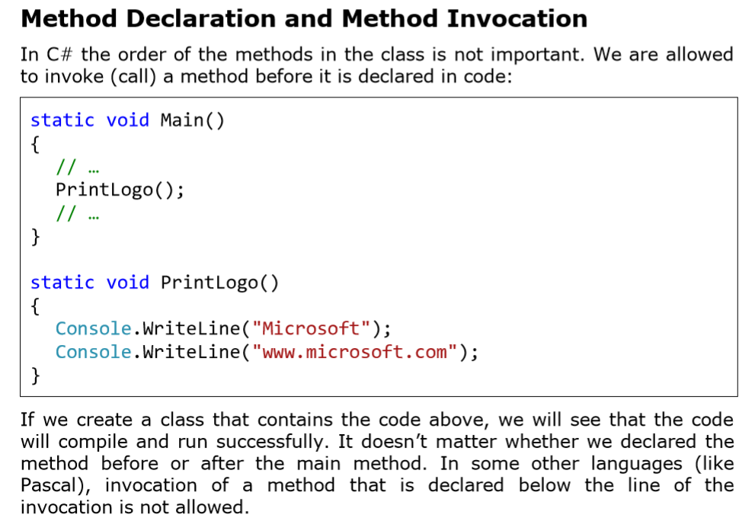

Slide 14
Exercises

Slide 15
Exercise 1
Write a code that by given name prints on the console "Hello, <name>!" (for example: "Hello, Peter!").

Slide 16
Exercise 2
Write a code that prints the name of a place and its location in separate lines. (Hint; be creative)
e.g
PACE Office
Adalyn Flats, along Ngong’ road

Slide 17
Exercise 5
Write a method that show whether a number is positive. (Hint; the method gets as input a number of type int, and according to it returns to the console "Positive", "Negative" or "Zero":)

Slide 18
Assignment

Slide 19
Assignment 1
Write a method that returns the English name of the last digit of a given number. Example: for 512 prints "two"; for 1024 → "four".

Slide 20
Assignment 2
Create a method GetMax() with two integer (int) parameters, that returns maximal of the two numbers. Write a program that reads three numbers from the console and prints the biggest of them. Use the GetMax() method you just created.

Slide 21
Assignment 3
Write a program in C# Sharp to read any Month Number in integer and display Month name in words. (Apply this for Days of the week)
{Use a method and switch cases}

Slide 22
Assignment 4
Write a method that determines the state of two numbers entered by the user. (Hint; the method gets two numbers of type int, and according to it returns to the console "Positive", "Negative" or "Zero“ for each of the integers:)

Slide 23

Assignment 5
Write a program that for a given (by the user) body temperature, measured in Fahrenheit degrees, has to convert that temperature and output it in Celsius degrees, with the following message: "Your body temperature in Celsius degrees is X", where X is respectively the Celsius degrees. In addition if the measured temperature in Celsius is higher than 37 degrees, the program should warn the user that they are ill, with the following message "You are ill!". {Hint; Use a method}
(Celsius to Fahrenheit formula : °C = (°F - 32) * 5 / 9, )

Slide 24
Assignment 6
Write a method that prints the digits of a given decimal number in a reversed order. For example 256, must be printed as 652.

Slide 25
Assignment 7
Create a program such that when you enter a character from the keyboard, the program checks if the input character is a letter. If it is a letter, it checks if it is lowercase or uppercase.
(Use Methods)

Slide 26
The End
Ooko Emmanuel

